Slide 1

Classifying Depression with Activity
Dave Storey and Spencer Lingwall

Slide 2



Agenda
What is the problem?
Dataset
Challenges we faced
Results from our experiments
Where to next?

Slide 3
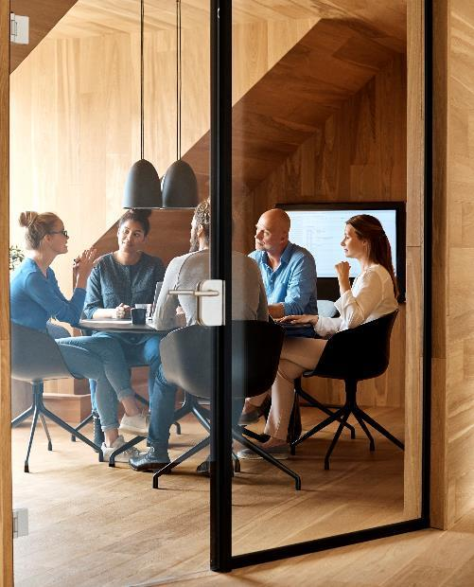



What is our Problem?
Depression is associated with disrupted biological rhythms caused by environmental disturbance like seasonal change in daylight, alteration of social rhythms due to for instance shift-work or longitude traveling.
We want to be able to classify depression based on a persons actigraph. Hopefully, this will allow doctors and other researchers to better diagnose depression.

Slide 4

The Dataset

Slide 5
What does our data look like?
55 people’s actigraphs and some basic information about them
Two groups of people: Condition (23) and Control (32)
The condition group also has information about if they were married, attending school, employed, and further information about their condition.

Slide 6
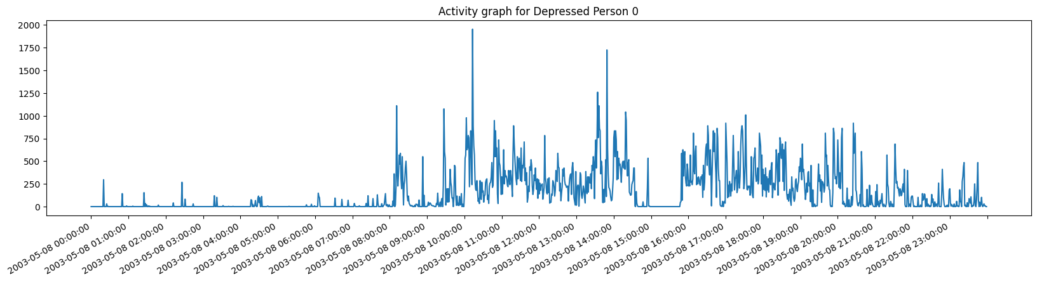
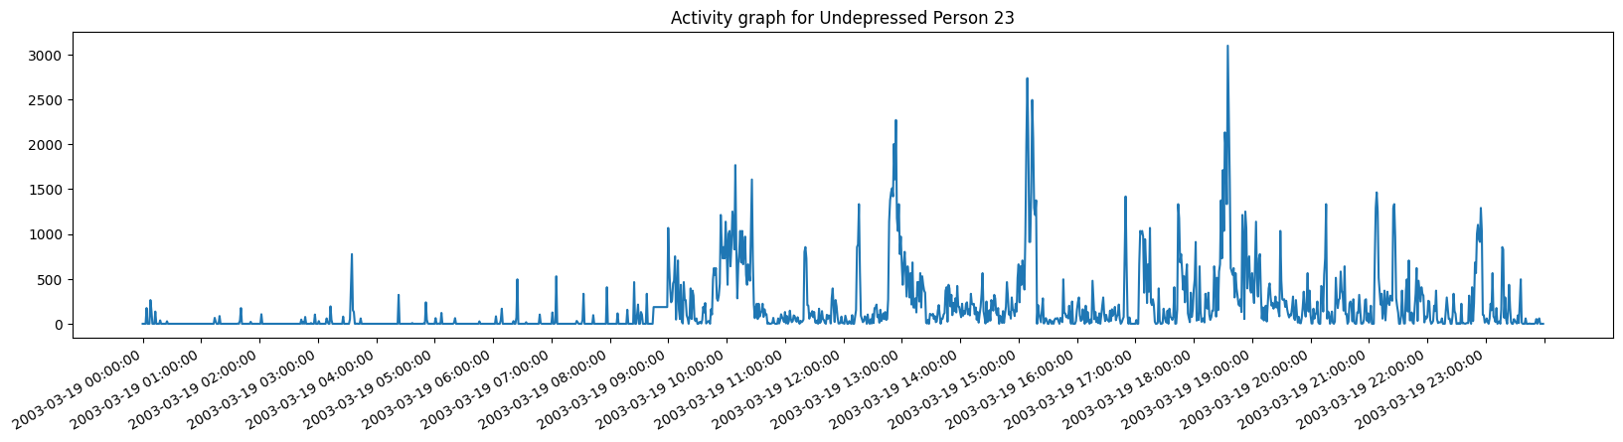
Actigraph of a Person

Slide 7

Challenges we Faced

Slide 8
Too Few Samples
55 Samples did not give us very much to work with. Our best accuracy was around 60%
To solve this, we ended up splitting each person into their days that they participated in the experiment with dramatically increased our sample size.

Slide 9
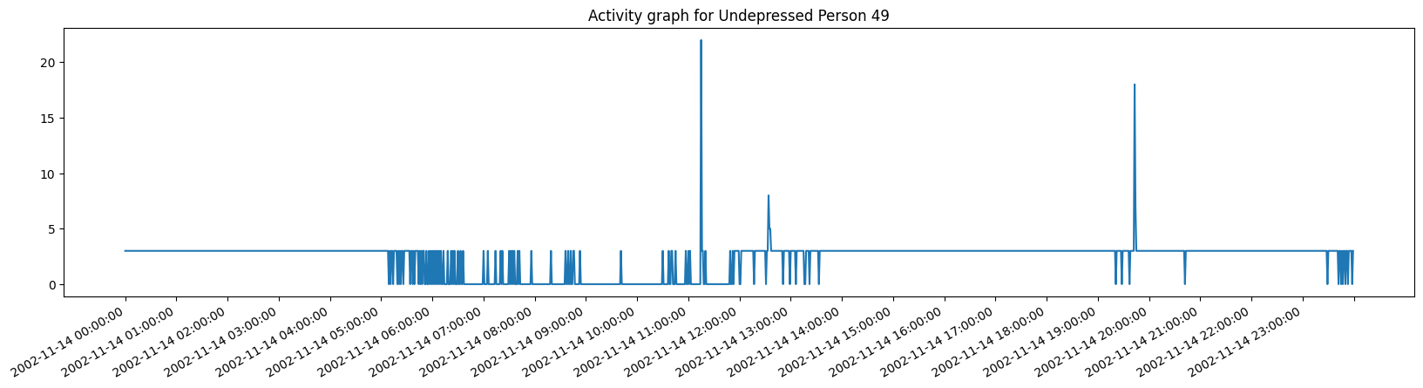
Bad Data

Slide 10
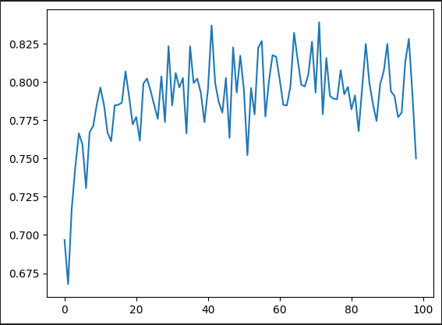
Tuning Hyper Parameters
We wanted to know how many trees to use in our forest classifier. We ran a series of experiments to find the optimal number and it appears that the accuracy peaks around 75 trees and then starts to give diminishing returns.
Notice though that the accuracy with 40 trees is about as good as 75. This means we can do less work and get about the same results.
Sidenote: 42 had the best accuracy

Slide 11
Results from our Experiments
Subtitle
subtitle
subtitle
Add text, images, art, and videos.
Add transitions, animations, and motion.
Save to OneDrive, to get to your presentations from your computer, tablet, or phone.
Open the Design Ideas pane for instant slide makeovers.
When we have design ideas, we’ll show them to you right there.
Add text, images, art, and videos.
Add transitions, animations, and motion.
Save to OneDrive, to get to your presentations from your computer, tablet, or phone.
Open the Design Ideas pane for instant slide makeovers.
When we have design ideas, we’ll show them to you right there.
Add text, images, art, and videos.
Add transitions, animations, and motion.
Save to OneDrive, to get to your presentations from your computer, tablet, or phone.
Open the Design Ideas pane for instant slide makeovers.
When we have design ideas, we’ll show them to you right there.

Slide 12

Where to next?
With PowerPoint, you can create presentations and share your work with others, wherever they are. Type the text you want here to get started. You can also add images, art, and videos on this template. Save to OneDrive and access your presentations from your computer, tablet, or phone.

Slide 13


Thank You
Dave Storey
Spencer Lingwall

